Slide 1
Radial-Basis Function Networks

Slide 2
Radial-Basis Function Networks
Radial-Basis Function network (RBF) is a three layers architecture:
Input Layer: The input layer is made up of source nodes that connect the network to its environment.
Hidden Layer: In this layer a nonlinear transformation is applied from the input space to the hidden space.
Output Layer: The output layer is linear, supplying the response of the network to the activation pattern applied to the input layer.

Slide 3
RBF ARCHITECTURE
x₁
One hidden layer with RBF activation functions
Output layer with linear activation function.
w₁
x₂
y
w_{m1}
x_{m}

Slide 4
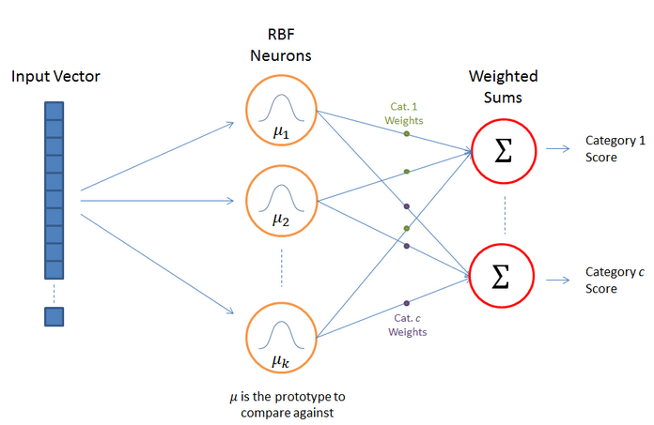
RBF Network Architecture

Slide 5
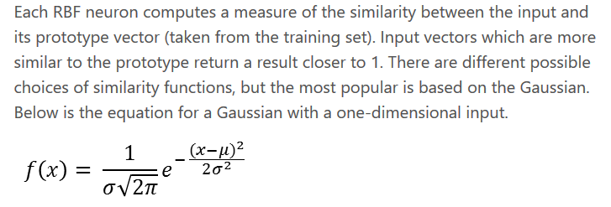
RBF Neuron Activation Function

Slide 6
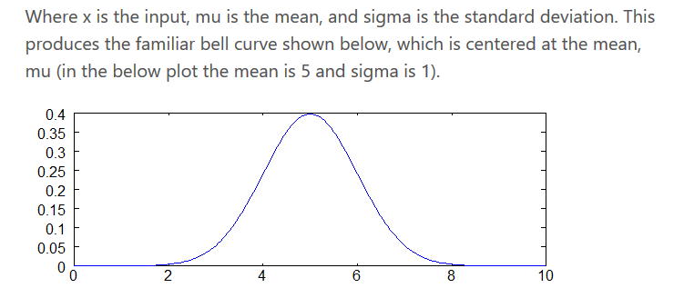

Slide 7
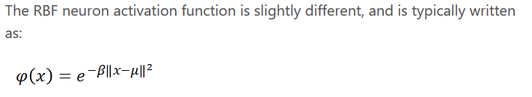
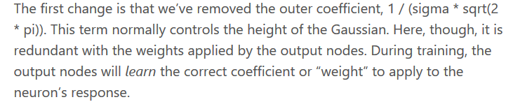
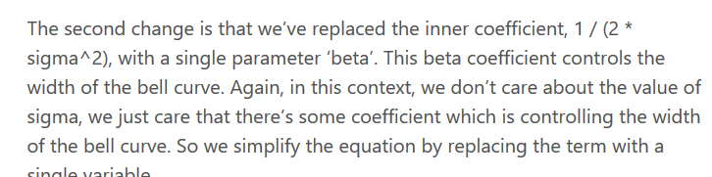
RBF neuron activation function

Slide 8
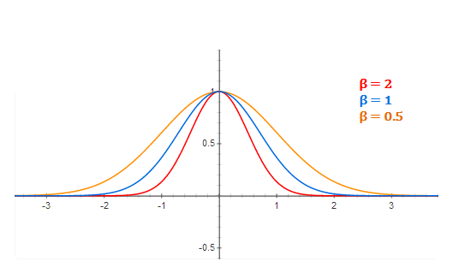
RBF Neuron activation for different values of beta

Slide 9

Training The RBFN

Slide 10
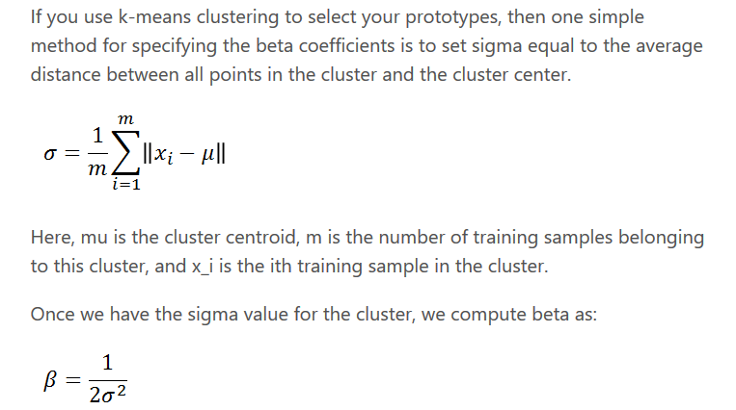
Selecting Beta Values

Slide 11
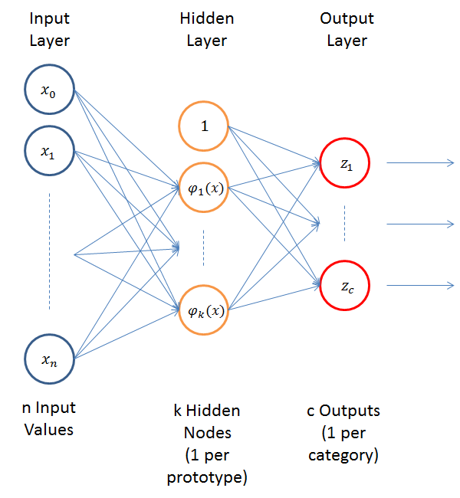
RBFN as a Neural Network

Slide 12
Example: XOR Problem
Input space:
Output space:
Construct an RBF pattern classifier such that:
(0,0) and (1,1) are mapped to 0, class C1
(1,0) and (0,1) are mapped to 1, class C2
x₂
(0,1)
(1,1)
x₁
(0,0)
(1,0)
0
1
y

Slide 13
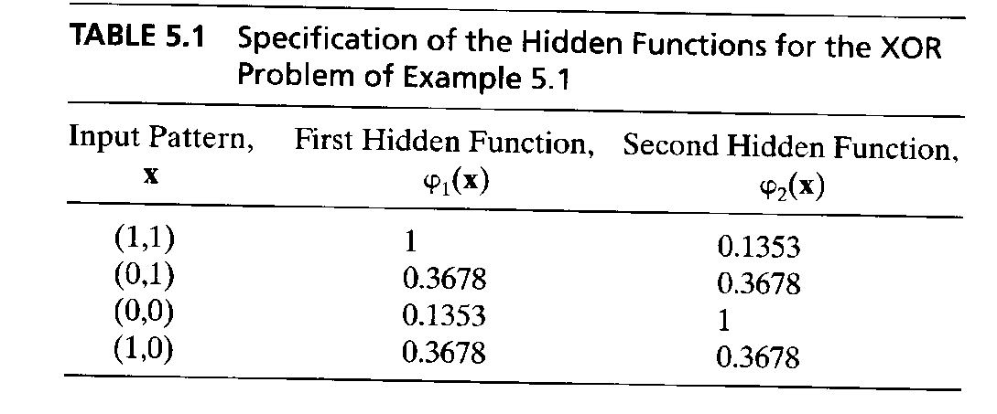
Example: the XOR problem
In the feature (hidden layer) space:
When mapped into the feature space < ϕ₁ , ϕ₂ > (hidden layer), C1 and C2 become linearly separable. So a linear classifier with ϕ₁(x) and ϕ₂(x) as inputs can be used to solve the XOR problem.
φ₂
(0,0)
Decision boundary
1.0
0.5
(1,1)
0.5
1.0
φ₁
(0,1) and (1,0)

Slide 14
RBF NN for the XOR problem
x₁
t1
W1=-1
y
x₂
t2
W2=-1
+1

Slide 15
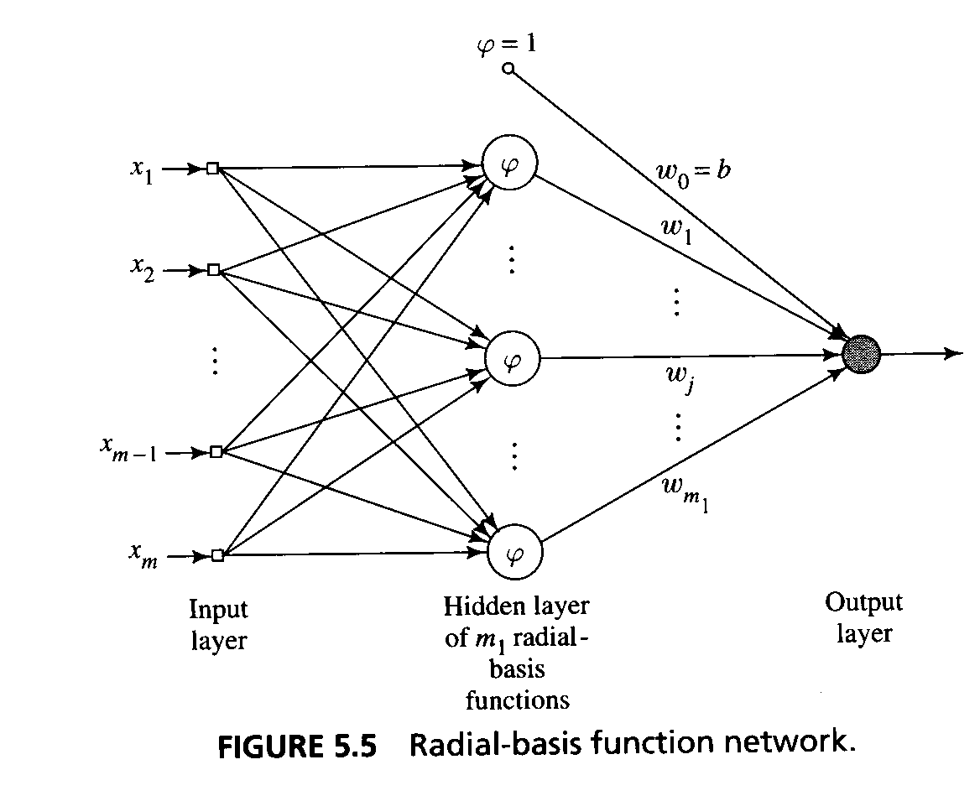
Generalized Radial-Basis Function Networks
When , i=1..N is large, the one-to-one correspondence between the training input data and the Green’s function produces a regularisation network that may be considered expensive.
An approximation of the regularized network.
x_{i}

Slide 16
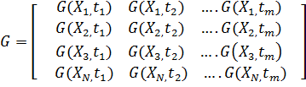

Example: XOR Problem
Table: Input output Transformation Computed for XOR problem
Data point, j | Input pattern, X_{j} | Desired output, d_{j}
1 | (1, 1) | 0
2 | (0,1) | 1
3 | (0,0) | 0
4 | (1,0) | 1
Where G is green’s function defined as:
Calculated as
G(||x - t_{i}||) = exp(- ) i=1,2

Slide 17

W= [w1 w2 b]^{T}
d=[0 1 0 1]^{T}
Where
And is a pseudo inverse of G
x₁
ψ1
W1
y
x₂
ψ2
W2
Input Nodes
b=+1
(bias)
Gaussian function
Thus the final input output relation of the network is defined as:

